Slide 1

Data Mining
Data

Slide 2
Outline
Attributes and Objects
Types of Data
Data Quality
Similarity and Distance
Data Preprocessing

Slide 3
What is Data?
Collection of data objects and their attributes
An attribute is a property or characteristic of an object
Examples: eye color of a person, temperature, etc.
Attribute is also known as variable, field, characteristic, dimension, or feature
A collection of attributes describe an object
Object is also known as record, point, case, sample, entity, or instance
Attributes
Objects

Slide 4
Attribute Values
Attribute values are numbers or symbols assigned to an attribute for a particular object
Distinction between attributes and attribute values
Same attribute can be mapped to different attribute values
Example: height can be measured in feet or meters
Different attributes can be mapped to the same set of values
Example: Attribute values for ID and age are integers
But properties of attribute can be different than the properties of the values used to represent the attribute

Slide 5
Attribute Types
Nominal: categories, states, or “names of things”
Hair_color = {auburn, black, blond, brown, grey, red, white}
marital status, occupation, ID numbers, zip codes
Examples: ID numbers, eye color, zip codes
Binary
Nominal attribute with only 2 states (0 and 1)
Symmetric binary: both outcomes equally important
e.g., gender
Asymmetric binary: outcomes not equally important.
e.g., medical test (positive vs. negative)
Convention: assign 1 to most important outcome (e.g., HIV positive)
Ordinal
Values have a meaningful order (ranking) but magnitude between successive values is not known.
Size = {small, medium, large}, grades, army rankings
Examples: rankings (e.g., taste of potato chips on a scale from 1-10), grades, height {tall, medium, short}

Slide 6
Numeric Attribute Types
Quantity (integer or real-valued)
Interval
Measured on a scale of equal-sized units
Values have order
E.g., temperature in C˚or F˚, calendar dates
No true zero-point
Ratio
Inherent zero-point
We can speak of values as being an order of magnitude larger than the unit of measurement (10 K˚ is twice as high as 5 K˚).
e.g., temperature in Kelvin, length, counts, monetary quantities

Slide 7
Properties of Attribute Values
The type of an attribute depends on which of the following properties/operations it possesses:
Distinctness: = ≠
Order: < >
Differences are + - meaningful :
Ratios are * / meaningful
Nominal attribute: distinctness
Ordinal attribute: distinctness & order
Interval attribute: distinctness, order & meaningful differences
Ratio attribute: all 4 properties/operations

Slide 8
Difference Between Ratio and Interval
Is it physically meaningful to say that a temperature of 10 ° is twice that of 5° on
the Celsius scale?
the Fahrenheit scale?
the Kelvin scale?
Consider measuring the height above average
If Bill’s height is three inches above average and Bob’s height is six inches above average, then would we say that Bob is twice as tall as Bill?
Is this situation analogous to that of temperature?

Slide 9
This categorization of attributes is due to S. S. Stevens

Slide 10
This categorization of attributes is due to S. S. Stevens

Slide 11
Discrete vs. Continuous Attributes
Discrete Attribute
Has only a finite or countably infinite set of values
E.g., zip codes, profession, or the set of words in a collection of documents
Sometimes, represented as integer variables
Note: Binary attributes are a special case of discrete attributes
Continuous Attribute
Has real numbers as attribute values
E.g., temperature, height, or weight
Practically, real values can only be measured and represented using a finite number of digits
Continuous attributes are typically represented as floating-point variables

Slide 12
Asymmetric Attributes
Only presence (a non-zero attribute value) is regarded as important
Words present in documents
Items present in customer transactions
If we met a friend in the grocery store would we ever say the following? “I see our purchases are very similar since we didn’t buy most of the same things.”

Slide 13
Critiques of the attribute categorization
Incomplete
Asymmetric binary
Cyclical
Multivariate
Partially ordered
Partial membership
Relationships between the data
Real data is approximate and noisy
This can complicate recognition of the proper attribute type
Treating one attribute type as another may be approximately correct

Slide 14
Important Characteristics of Data
Dimensionality (number of attributes)
High dimensional data brings a number of challenges
Sparsity
Only presence counts
Resolution
Patterns depend on the scale
Size
Type of analysis may depend on size of data

Slide 15
Basic Statistical Descriptions of Data
Motivation
To better understand the data: central tendency, variation and spread
Data dispersion characteristics
median, max, min, quantiles, outliers, variance, etc.
Numerical dimensions correspond to sorted intervals
Data dispersion: analyzed with multiple granularities of precision
Boxplot or quantile analysis on sorted intervals
Dispersion analysis on computed measures
Refers to examining how much variation or spread exists
Folding measures into numerical dimensions
Boxplot or quantile analysis on the transformed cube

Slide 16
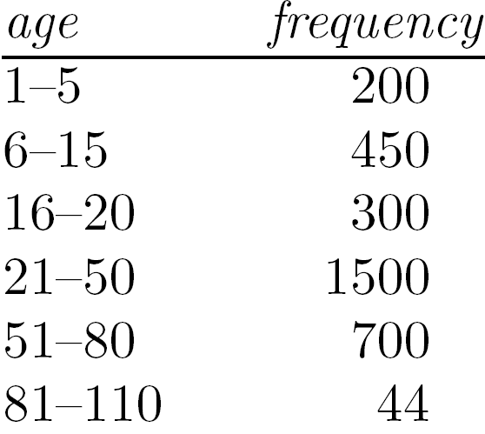
Measuring the Central Tendency
Mean (algebraic measure) (sample vs. population):
Note: n is sample size and N is population size.
Weighted arithmetic mean:
Trimmed mean: chopping extreme values
Median:
Middle value if odd number of values, or average of the middle two values otherwise
Estimated by interpolation (for grouped data):
Mode
Value that occurs most frequently in the data
Unimodal, bimodal, trimodal
Empirical formula:

Slide 17
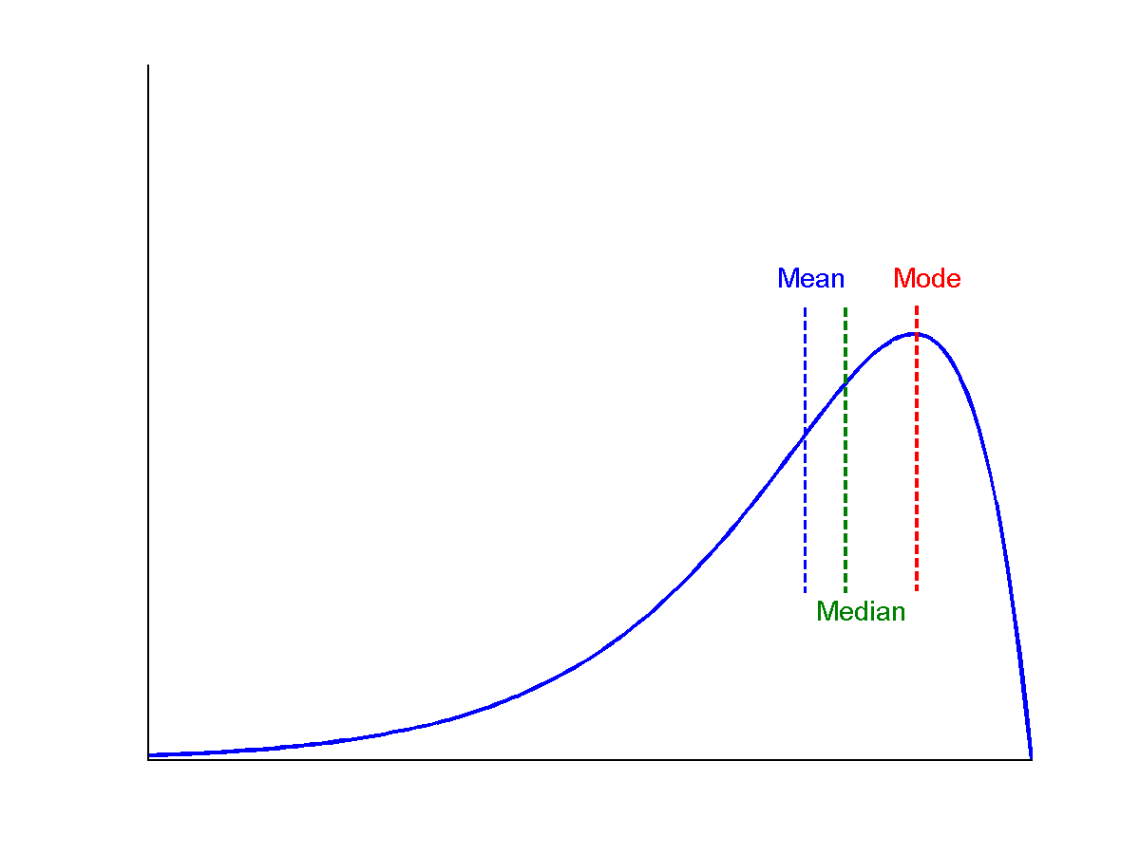
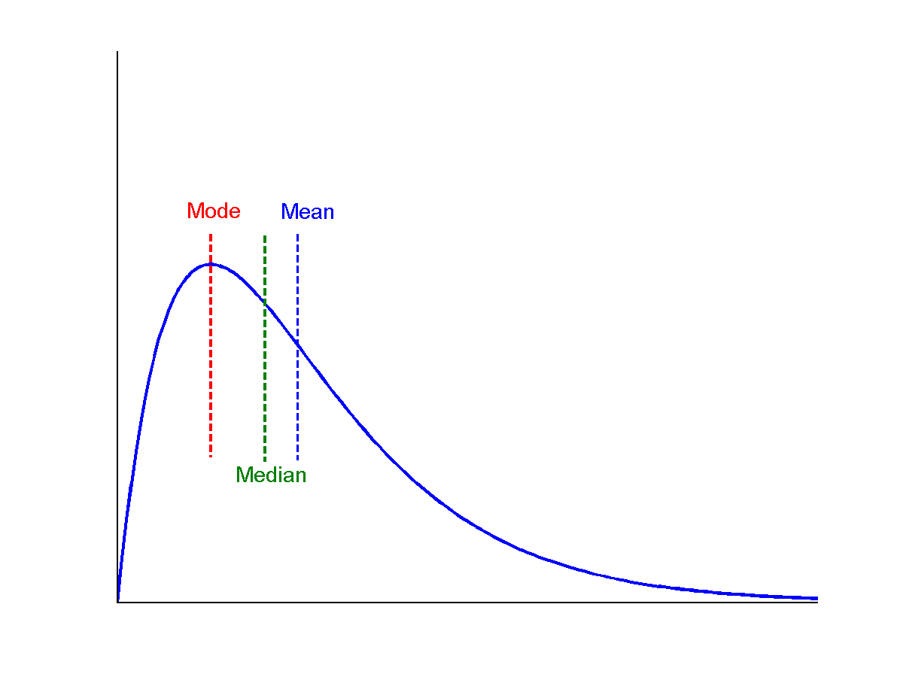
Symmetric vs. Skewed Data
Median, mean and mode of symmetric, positively and negatively skewed data
symmetric
positively skewed
negatively skewed

Slide 18
Measuring the Dispersion of Data
Quartiles, outliers and boxplots
Quartiles: Q₁ (25th percentile), Q₃ (75th percentile)
Inter-quartile range: IQR = Q₃ – Q₁
Five number summary: min, Q₁, median, Q₃, max
Boxplot: ends of the box are the quartiles; median is marked; add whiskers, and plot outliers individually
Outlier: usually, a value higher/lower than 1.5 x IQR
Variance and standard deviation (sample: s, population: σ)
Variance: (algebraic, scalable computation)
Standard deviation s (or σ) is the square root of variance s² ⁽or σ²⁾

Slide 19
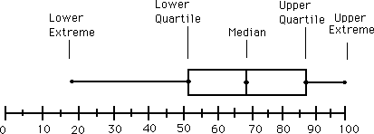
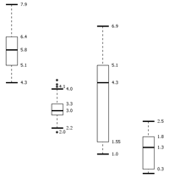
Boxplot Analysis
Five-number summary of a distribution
Minimum, Q1, Median, Q3, Maximum
Boxplot
Data is represented with a box
The ends of the box are at the first and third quartiles, i.e., the height of the box is IQR
The median is marked by a line within the box
Whiskers: two lines outside the box extended to Minimum and Maximum
Outliers: points beyond a specified outlier threshold, plotted individually

Slide 20
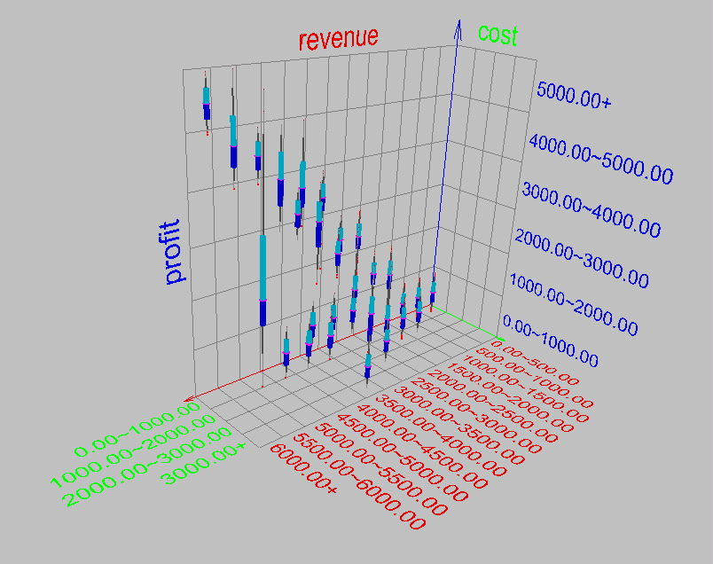
Visualization of Data Dispersion: 3-D Boxplots

Slide 21
Properties of Normal Distribution Curve
The normal (distribution) curve
From μ–σ to μ+σ: contains about 68% of the measurements (μ: mean, σ: standard deviation)
From μ–2σ to μ+2σ: contains about 95% of it
From μ–3σ to μ+3σ: contains about 99.7% of it

Slide 22
Graphic Displays of Basic Statistical Descriptions
Boxplot: graphic display of five-number summary
Histogram: x-axis are values, y-axis repres. frequencies
Quantile plot: each value x_{i} is paired with f_{i} indicating that approximately 100 f_{i} % of data are ≤ x_{i}
Quantile-quantile (q-q) plot: graphs the quantiles of one univariant distribution against the corresponding quantiles of another
Scatter plot: each pair of values is a pair of coordinates and plotted as points in the plane

Slide 23
Histogram Analysis
Histogram: Graph display of tabulated frequencies, shown as bars
It shows what proportion of cases fall into each of several categories
Differs from a bar chart in that it is the area of the bar that denotes the value, not the height as in bar charts, a crucial distinction when the categories are not of uniform width
The categories are usually specified as non-overlapping intervals of some variable. The categories (bars) must be adjacent

Slide 24
Histograms Often Tell More than Boxplots
The two histograms shown in the left may have the same boxplot representation
The same values for: min, Q1, median, Q3, max
But they have rather different data distributions

Slide 25
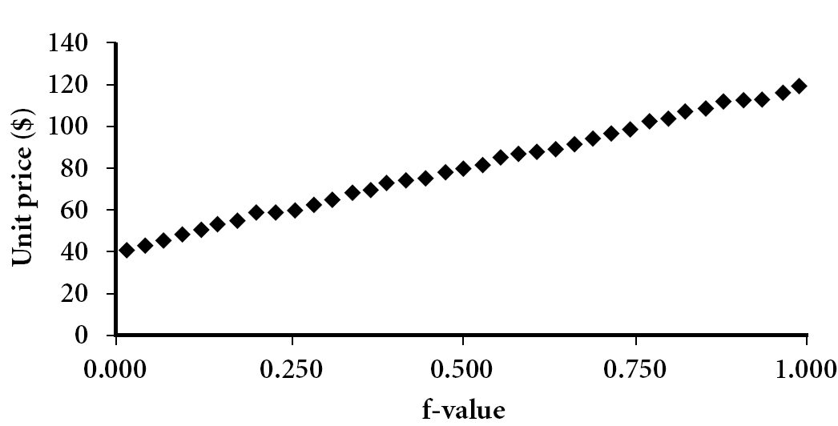
Quantile Plot
Displays all of the data (allowing the user to assess both the overall behavior and unusual occurrences)
Plots quantile information
For a data x_{i} data sorted in increasing order, f_{i} indicates that approximately 100 f_{i}% of the data are below or equal to the value x_{i}

Slide 26
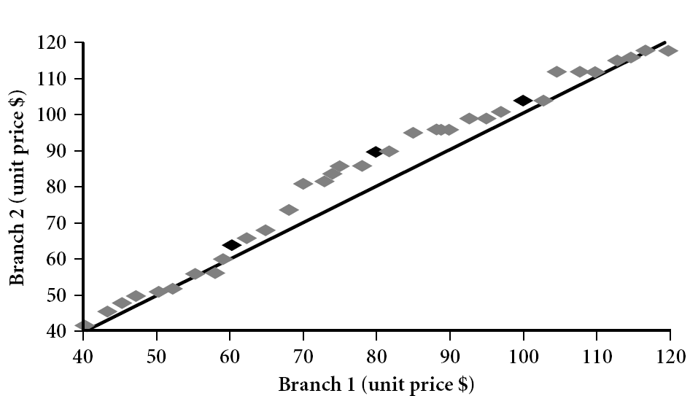
Quantile-Quantile (Q-Q) Plot
Graphs the quantiles of one univariate distribution against the corresponding quantiles of another
View: Is there is a shift in going from one distribution to another?
Example shows unit price of items sold at Branch 1 vs. Branch 2 for each quantile. Unit prices of items sold at Branch 1 tend to be lower than those at Branch 2.
Notes:
Note: We need to label the dark plotted points as Q1, Median, Q3 – that would help in understanding this graph.
Tell audience: There is a shift in distribution of branch 1 WRT branch 2 in that the unit prices of items sold at branch 1 tend to be lower than those at branch 2.

Slide 27
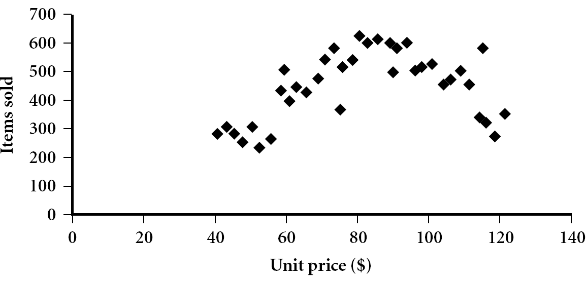
Scatter plot
Provides a first look at bivariate data to see clusters of points, outliers, etc
Each pair of values is treated as a pair of coordinates and plotted as points in the plane

Slide 28
Positively and Negatively Correlated Data
The left half fragment is positively correlated
The right half is negative correlated

Slide 29
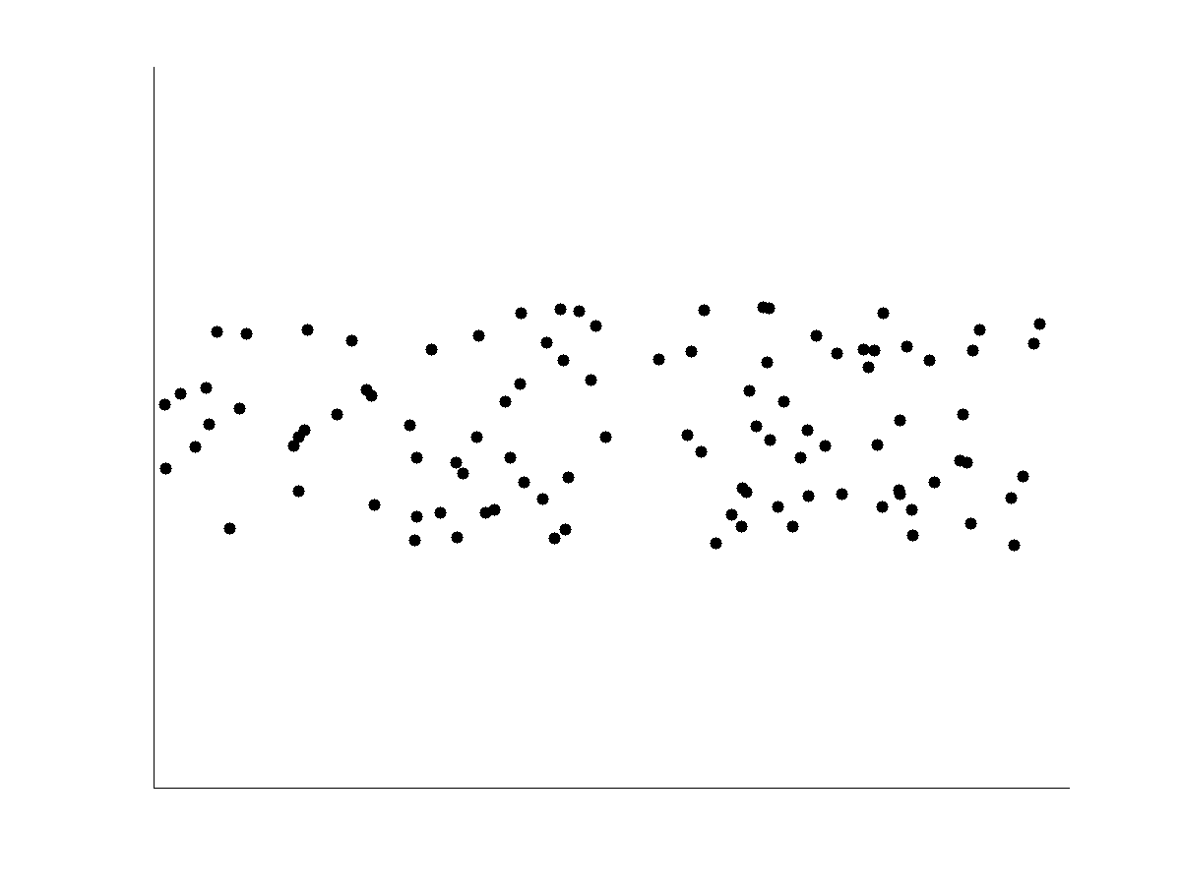
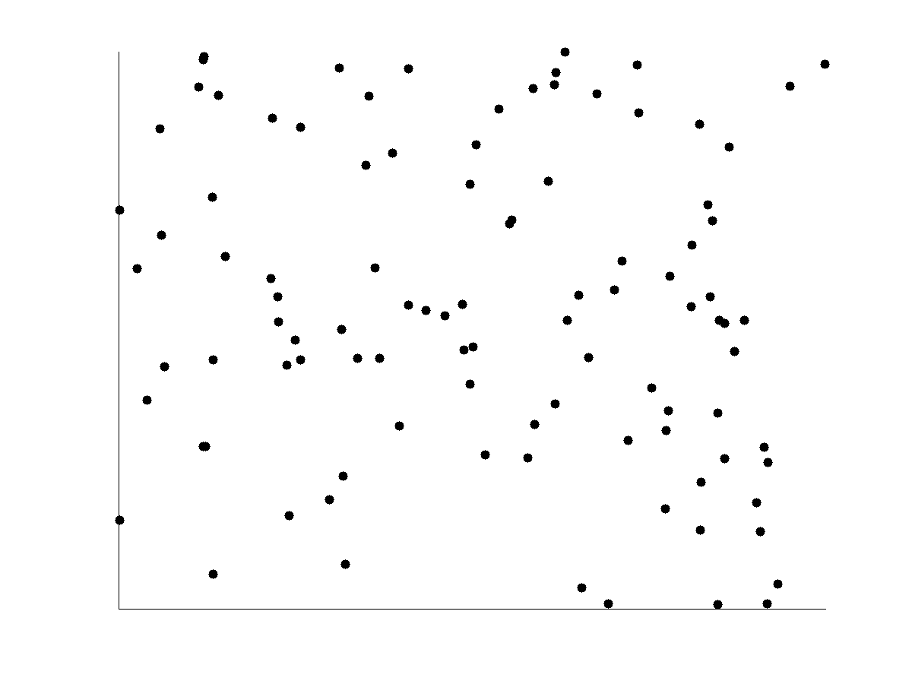
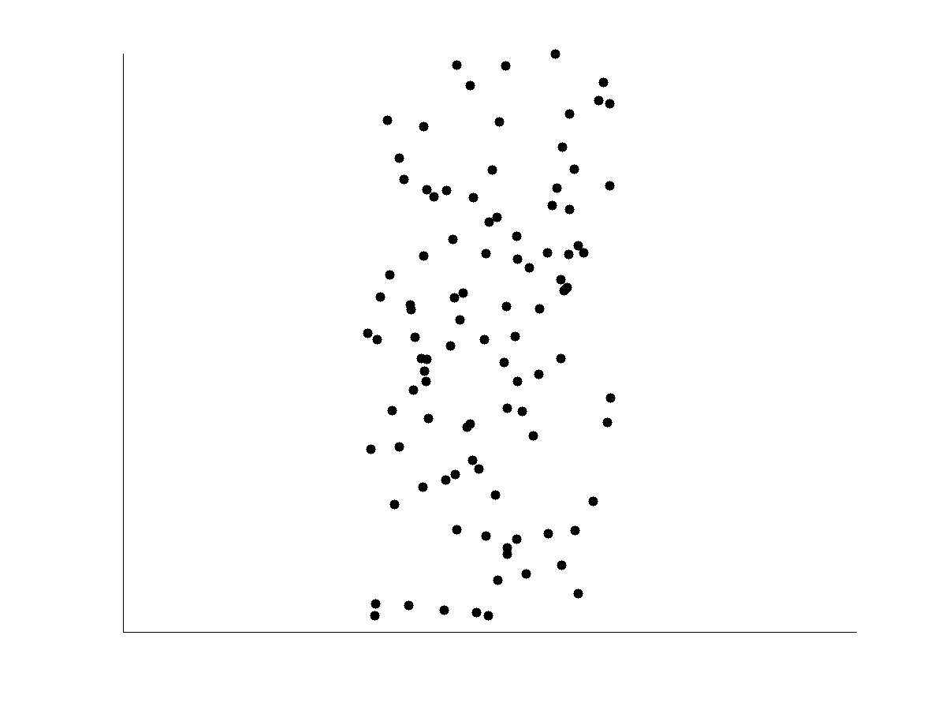
Uncorrelated Data

Slide 30
Data Visualization
Why data visualization?
Gain insight into an information space by mapping data onto graphical primitives
Provide qualitative overview of large data sets
Search for patterns, trends, structure, irregularities, relationships among data
Help find interesting regions and suitable parameters for further quantitative analysis
Provide a visual proof of computer representations derived
Categorization of visualization methods:
Pixel-oriented visualization techniques
Geometric projection visualization techniques
Icon-based visualization techniques
Hierarchical visualization techniques
Visualizing complex data and relations

Slide 31
Pixel-Oriented Visualization Techniques
For a data set of m dimensions, create m windows on the screen, one for each dimension
The m dimension values of a record are mapped to m pixels at the corresponding positions in the windows
The colors of the pixels reflect the corresponding values
Income
(b) Credit Limit
(c) transaction volume
(d) age
31
Notes:
31

Slide 32
Laying Out Pixels in Circle Segments
To save space and show the connections among multiple dimensions, space filling is often done in a circle segment
Representing a data record in circle segment
(b) Laying out pixels in circle segment
32
Notes:
32

Slide 33
Geometric Projection Visualization Techniques
Visualization of geometric transformations and projections of the data
Methods
Direct visualization
Scatterplot and scatterplot matrices
Landscapes
Projection pursuit technique: Help users find meaningful projections of multidimensional data
Prosection views
Hyperslice
Parallel coordinates

Slide 34
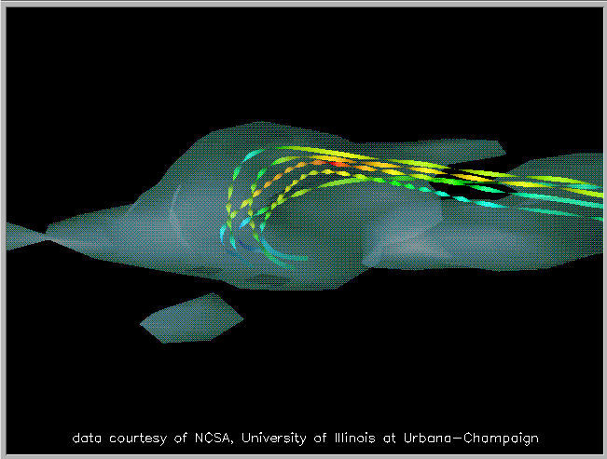
Direct Data Visualization
Ribbons with Twists Based on Vorticity
Notes:
http://books.elsevier.com/companions/1558606890/pictures/Chapter_01/fig1-6b.gif

Slide 35
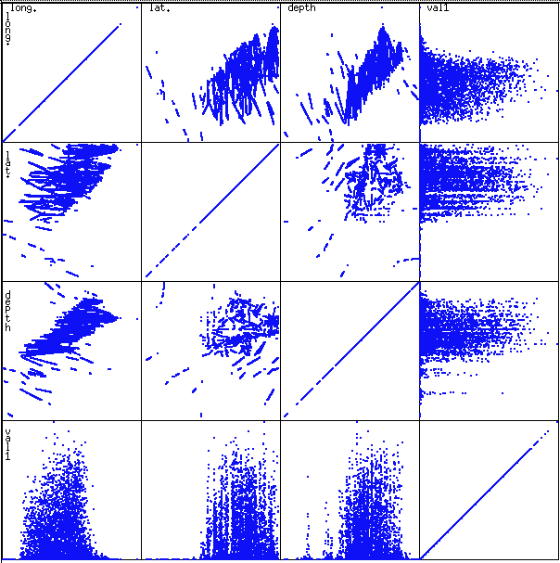
Scatterplot Matrices
Used by ermission of M. Ward, Worcester Polytechnic Institute
Matrix of scatterplots (x-y-diagrams) of the k-dim. data [total of (k2/2-k) scatterplots]

Slide 36
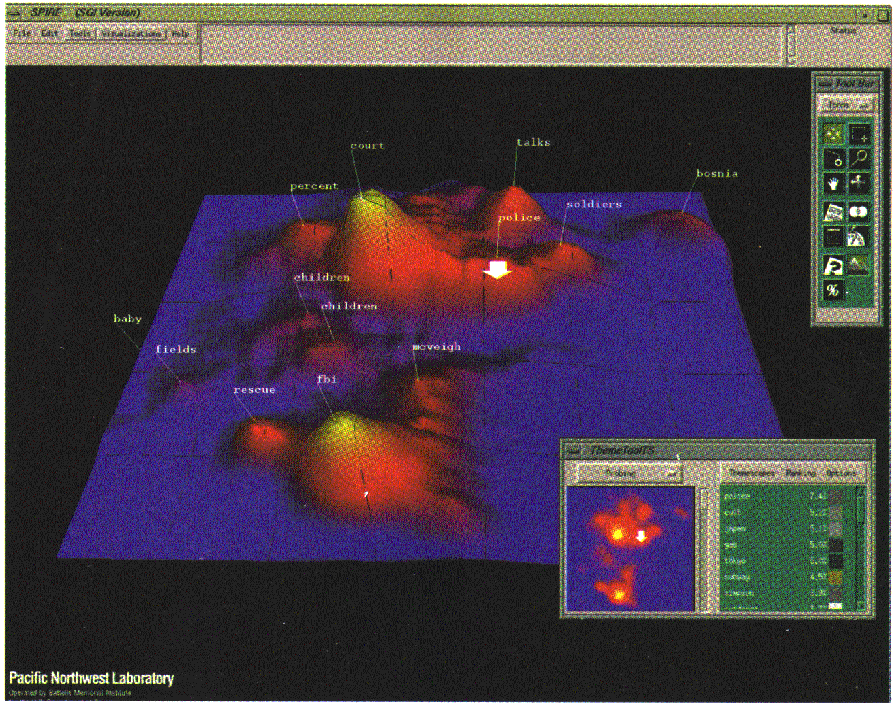
Landscapes
news articles visualized as a landscape
Used by permission of B. Wright, Visible Decisions Inc.
Visualization of the data as perspective landscape
The data needs to be transformed into a (possibly artificial) 2D spatial representation which preserves the characteristics of the data

Slide 37
Parallel Coordinates
n equidistant axes which are parallel to one of the screen axes and correspond to the attributes
The axes are scaled to the [minimum, maximum]: range of the corresponding attribute
Every data item corresponds to a polygonal line which intersects each of the axes at the point which corresponds to the value for the attribute

Slide 38
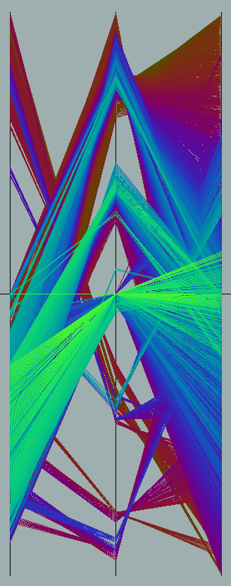
Parallel Coordinates of a Data Set

Slide 39
Icon-Based Visualization Techniques
Visualization of the data values as features of icons
Typical visualization methods
Chernoff Faces
Stick Figures
General techniques
Shape coding: Use shape to represent certain information encoding
Color icons: Use color icons to encode more information
Tile bars: Use small icons to represent the relevant feature vectors in document retrieval

Slide 40
Hierarchical Visualization Techniques
Visualization of the data using a hierarchical partitioning into subspaces
Methods
Dimensional Stacking
Worlds-within-Worlds
Tree-Map
Cone Trees
InfoCube

Slide 41
Dimensional Stacking
Partitioning of the n-dimensional attribute space in 2-D subspaces, which are ‘stacked’ into each other
Partitioning of the attribute value ranges into classes. The important attributes should be used on the outer levels.
Adequate for data with ordinal attributes of low cardinality
But, difficult to display more than nine dimensions
Important to map dimensions appropriately

Slide 42
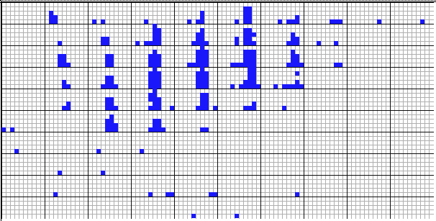
Dimensional Stacking
Used by permission of M. Ward, Worcester Polytechnic Institute
Visualization of oil mining data with longitude and latitude mapped to the outer x-, y-axes and ore grade and depth mapped to the inner x-, y-axes

Slide 43
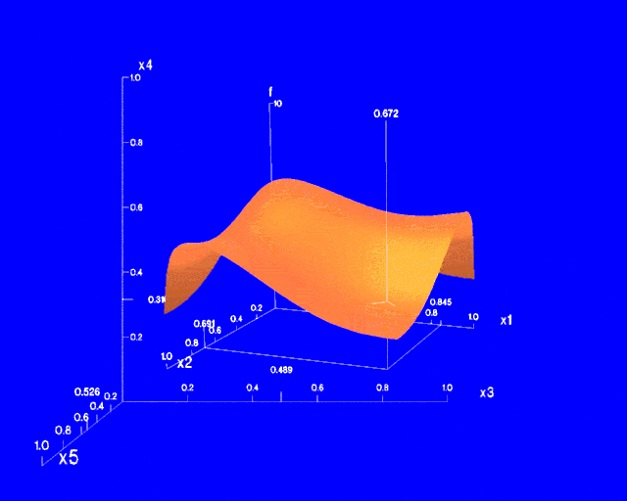
Worlds-within-Worlds
Assign the function and two most important parameters to innermost world
Fix all other parameters at constant values - draw other (1 or 2 or 3 dimensional worlds choosing these as the axes)
Software that uses this paradigm
N–vision: Dynamic interaction through data glove and stereo displays, including rotation, scaling (inner) and translation (inner/outer)
Auto Visual: Static interaction by means of queries

Slide 44
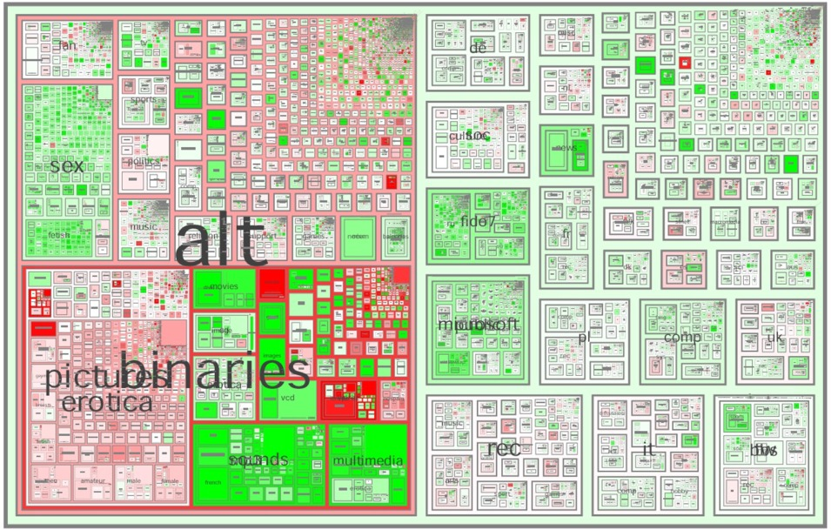
Tree-Map
Screen-filling method which uses a hierarchical partitioning of the screen into regions depending on the attribute values
The x- and y-dimension of the screen are partitioned alternately according to the attribute values (classes)
MSR Netscan Image
Ack.: http://www.cs.umd.edu/hcil/treemap-history/all102001.jpg

Slide 45
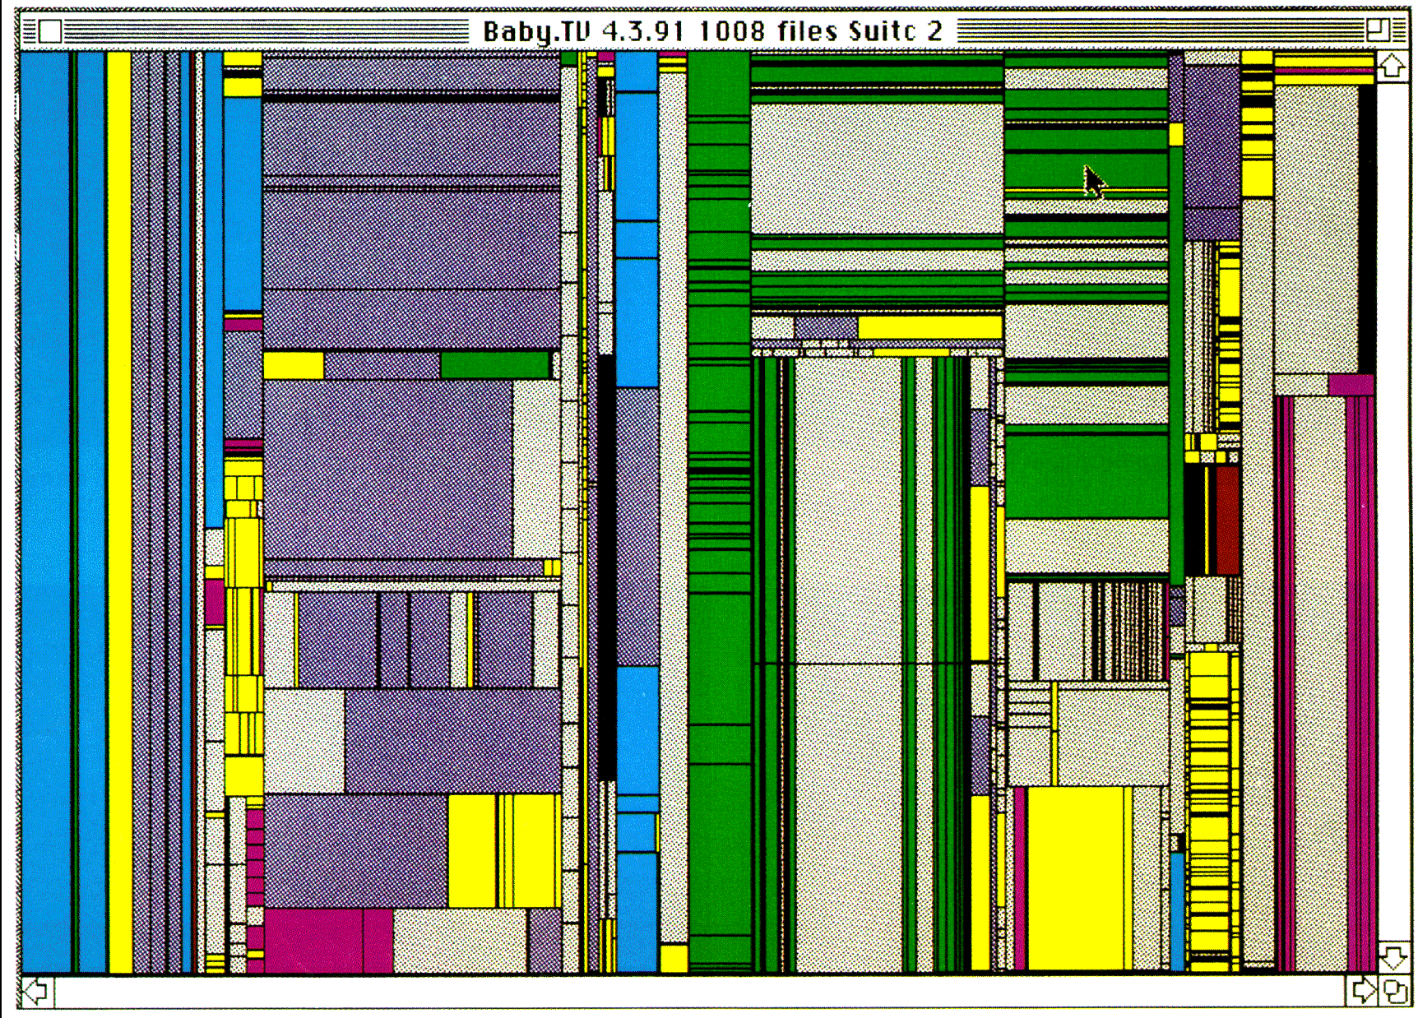
Tree-Map of a File System (Schneiderman)

Slide 46

InfoCube
A 3-D visualization technique where hierarchical information is displayed as nested semi-transparent cubes
The outermost cubes correspond to the top level data, while the subnodes or the lower level data are represented as smaller cubes inside the outermost cubes, and so on

Slide 47
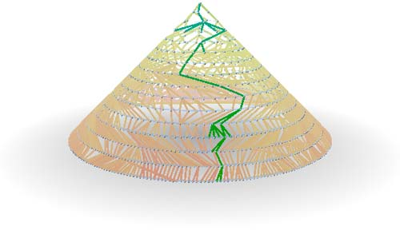
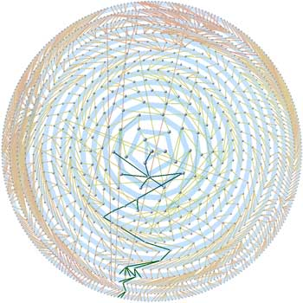
Three-D Cone Trees
3D cone tree visualization technique works well for up to a thousand nodes or so
First build a 2D circle tree that arranges its nodes in concentric circles centered on the root node
Cannot avoid overlaps when projected to 2D
G. Robertson, J. Mackinlay, S. Card. “Cone Trees: Animated 3D Visualizations of Hierarchical Information”, ACM SIGCHI'91
Graph from Nadeau Software Consulting website: Visualize a social network data set that models the way an infection spreads from one person to the next
Ack.: http://nadeausoftware.com/articles/visualization

Slide 48
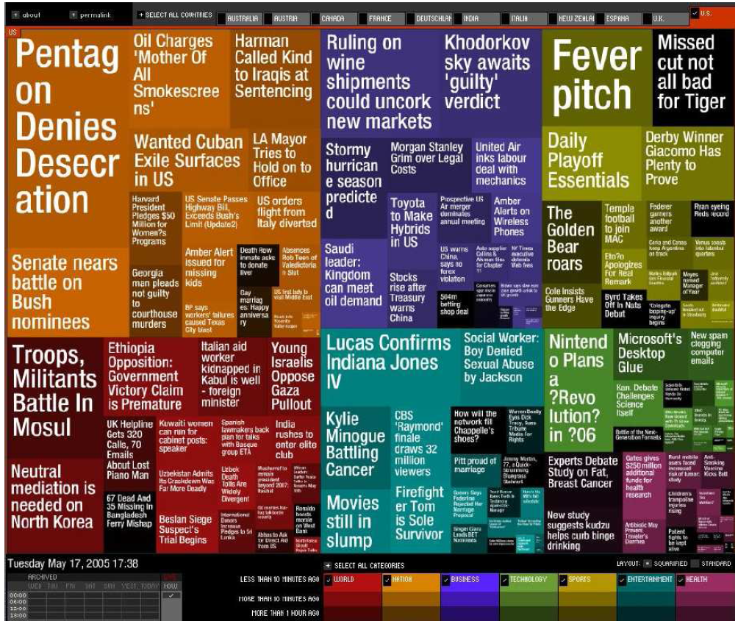
Visualizing Complex Data and Relations
Visualizing non-numerical data: text and social networks
Tag cloud: visualizing user-generated tags
The importance of tag is represented by font size/color
Besides text data, there are also methods to visualize relationships, such as visualizing social networks
Newsmap: Google News Stories in 2005

Slide 49
Types of data sets
Record
Data Matrix
Document Data
Transaction Data
Graph
World Wide Web
Molecular Structures
Ordered
Spatial Data
Temporal Data
Sequential Data
Genetic Sequence Data

Slide 50
Record Data
Data that consists of a collection of records, each of which consists of a fixed set of attributes

Slide 51
Data Matrix
If data objects have the same fixed set of numeric attributes, then the data objects can be thought of as points in a multi-dimensional space, where each dimension represents a distinct attribute
Such a data set can be represented by an m by n matrix, where there are m rows, one for each object, and n columns, one for each attribute

Slide 52
Document Data
Each document becomes a ‘term’ vector
Each term is a component (attribute) of the vector
The value of each component is the number of times the corresponding term occurs in the document.

Slide 53
Transaction Data
A special type of data, where
Each transaction involves a set of items.
For example, consider a grocery store. The set of products purchased by a customer during one shopping trip constitute a transaction, while the individual products that were purchased are the items.
Can represent transaction data as record data

Slide 54
Graph Data
Examples: Generic graph, a molecule, and webpages
Benzene Molecule: C6H6

Slide 55
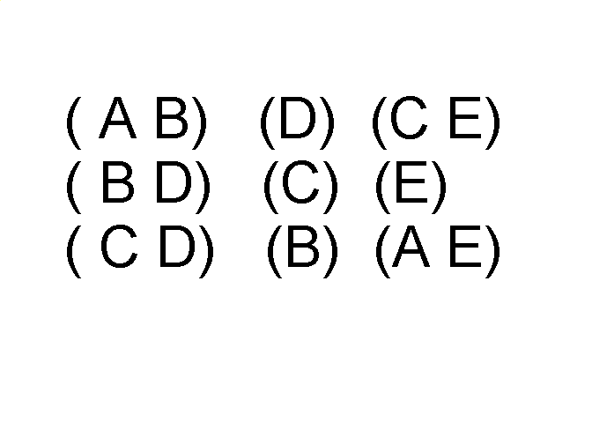
Ordered Data
Sequences of transactions
Items/Events
An element of the sequence

Slide 56
Ordered Data
Genomic sequence data

Slide 57
Ordered Data
Spatio-Temporal Data
Average Monthly Temperature of land and ocean

Slide 58
Data Quality
Poor data quality negatively affects many data processing efforts
Data mining example: a classification model for detecting people who are loan risks is built using poor data
Some credit-worthy candidates are denied loans
More loans are given to individuals that default

Slide 59
Data Quality …
What kinds of data quality problems?
How can we detect problems with the data?
What can we do about these problems?
Examples of data quality problems:
Noise and outliers
Wrong data
Fake data
Missing values
Duplicate data

Slide 60
Noise
For objects, noise is an extraneous object
For attributes, noise refers to modification of original values
Examples: distortion of a person’s voice when talking on a poor phone and “snow” on television screen
The figures below show two sine waves of the same magnitude and different frequencies, the waves combined, and the two sine waves with random noise
The magnitude and shape of the original signal is distorted

Slide 61
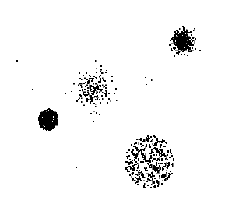
Outliers
Outliers are data objects with characteristics that are considerably different than most of the other data objects in the data set
Case 1: Outliers are noise that interferes with data analysis
Case 2: Outliers are the goal of our analysis
Credit card fraud
Intrusion detection
Causes?

Slide 62
Missing Values
Reasons for missing values
Information is not collected (e.g., people decline to give their age and weight)
Attributes may not be applicable to all cases (e.g., annual income is not applicable to children)
Handling missing values
Eliminate data objects or variables
Estimate missing values
Example: time series of temperature
Example: census results
Ignore the missing value during analysis

Slide 63
Similarity and Dissimilarity
Similarity
Numerical measure of how alike two data objects are
Value is higher when objects are more alike
Often falls in the range [0,1]
Dissimilarity (e.g., distance)
Numerical measure of how different two data objects are
Lower when objects are more alike
Minimum dissimilarity is often 0
Upper limit varies
Proximity refers to a similarity or dissimilarity

Slide 64
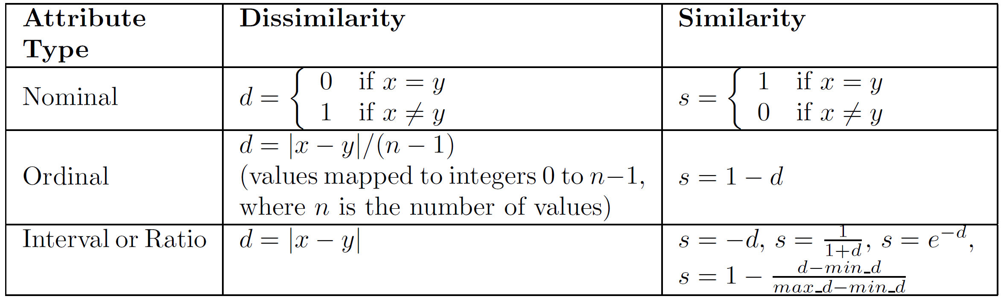
Similarity/Dissimilarity for Simple Attributes
The following table shows the similarity and dissimilarity between two objects, x and y, with respect to a single, simple attribute.

Slide 65
Proximity Measure for Nominal Attributes
Can take 2 or more states, e.g., red, yellow, blue, green (generalization of a binary attribute)
Method 1: Simple matching
m: # of matches, p: total # of variables
Method 2: Use a large number of binary attributes
creating a new binary attribute for each of the M nominal states

Slide 66
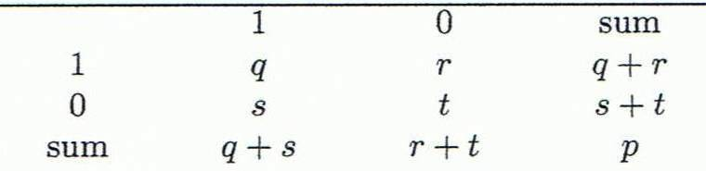
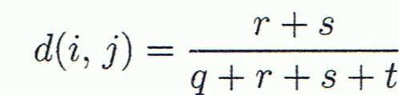
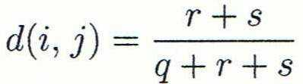

Proximity Measure for Binary Attributes
Object j
A contingency table for binary data
Distance measure for symmetric binary variables:
Distance measure for asymmetric binary variables:
Jaccard coefficient (similarity measure for asymmetric binary variables):
Object i
Note: Jaccard coefficient is the same as “coherence”:

Slide 67
Standardizing Numeric Data
Z-score:
X: raw score to be standardized, μ: mean of the population, σ: standard deviation
the distance between the raw score and the population mean in units of the standard deviation
negative when the raw score is below the mean, “+” when above
An alternative way: Calculate the mean absolute deviation
where
standardized measure (z-score):
Using mean absolute deviation is more robust than using standard deviation

Slide 68
Distance on Numeric Data: Minkowski Distance
Minkowski distance: A popular distance measure
where i = (x_{i1}, x_{i2}, …, x_{ip}) and j = (x_{j1}, x_{j2}, …, x_{jp}) are two p-dimensional data objects, and h is the order (the distance so defined is also called L-h norm)
Properties
d(i, j) > 0 if i ≠ j, and d(i, i) = 0 (Positive definiteness)
d(i, j) = d(j, i) (Symmetry)
d(i, j) ≤ d(i, k) + d(k, j) (Triangle Inequality)
A distance that satisfies these properties is a metric

Slide 69
Special Cases of Minkowski Distance
h = 1: Manhattan (city block, L₁ norm) distance
E.g., the Hamming distance: the number of bits that are different between two binary vectors
h = 2: (L₂ norm) Euclidean distance
h → ∞. “supremum” (L_{max} norm, L∞ norm) distance.
This is the maximum difference between any component (attribute) of the vectors

Slide 70
Example: Minkowski Distance
Dissimilarity Matrices
Manhattan (L₁)
Euclidean (L₂)
Supremum

Slide 71
Attributes of Mixed Type
A database may contain all attribute types
Nominal, symmetric binary, asymmetric binary, numeric, ordinal
One may use a weighted formula to combine their effects
f is binary or nominal:
d_{ij}^{(f)} = 0 if x_{if} = x_{jf} , or d_{ij}^{(f)} = 1 otherwise
f is numeric: use the normalized distance
f is ordinal
Compute ranks r_{if} and
Treat z_{if} as interval-scaled

Slide 72
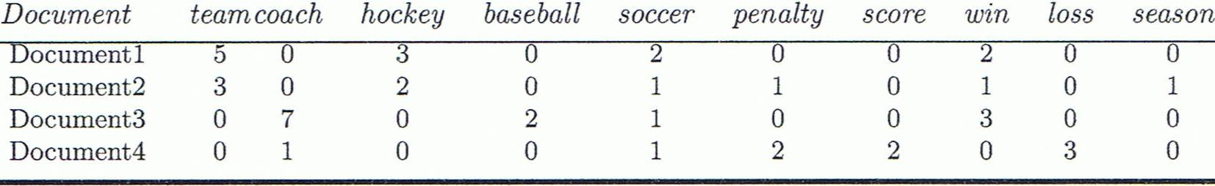
Cosine Similarity
A document can be represented by thousands of attributes, each recording the frequency of a particular word (such as keywords) or phrase in the document.
Other vector objects: gene features in micro-arrays, …
Applications: information retrieval, biologic taxonomy, gene feature mapping, ...
Cosine measure: If d₁ and d₂ are two vectors (e.g., term-frequency vectors), then
cos(d₁, d₂) = (d₁ • d₂) /||d₁|| ||d₂|| ,
where • indicates vector dot product, ||d||: the length of vector d

Slide 73
Duplicate Data
Data set may include data objects that are duplicates, or almost duplicates of one another
Major issue when merging data from heterogeneous sources
Examples:
Same person with multiple email addresses
Data cleaning
Process of dealing with duplicate data issues
When should duplicate data not be removed?

Slide 74

Thanks

